Slide 1
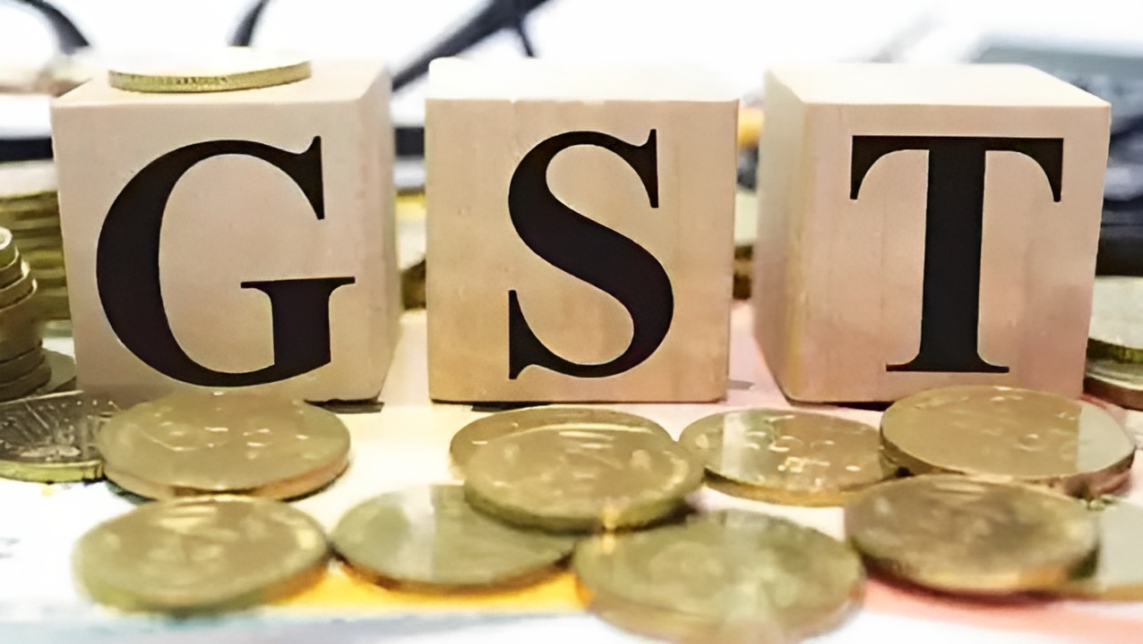
COMPARISON OF IMPACT OF IMPLEMENTATION OF GST IN KERALA, MANIPUR, MAHARASHTRA
GEOSPATIAL PROJECT ECONOMICS AND MANAGEMENT

Slide 2
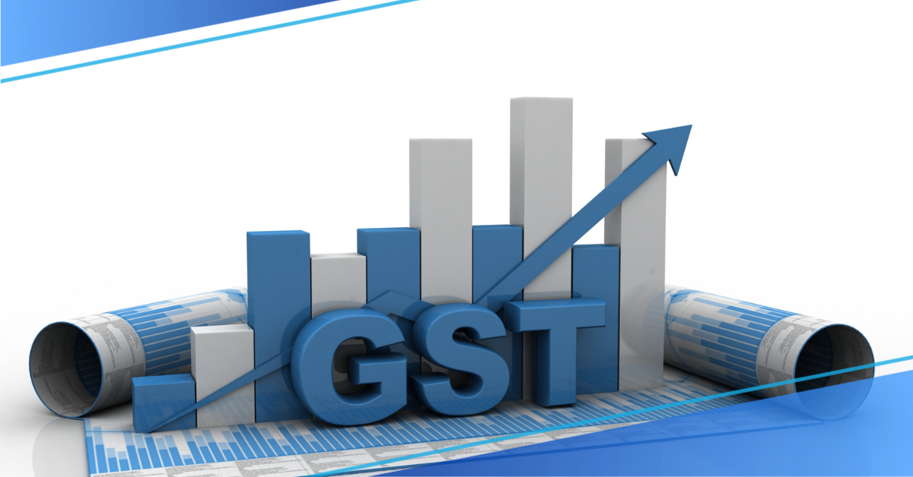





Table of content
Dataset used
Location considered for analysis
Analysis of parameter, inference
Validation
Conclusion

Slide 3

Dataset used
Night time light data:
Nighttime light data can be used as a proxy for economic activity, as areas with more nighttime lights tend to have higher levels of economic activity. The implementation of GST in India had a significant impact on the economy, and this impact is likely to be reflected in changes in economic activity, which can be detected through changes in nighttime light intensity.
VIIRS Stray Light Corrected Nighttime Day/Night Band Composites Version 1

Slide 4
Dataset used
Build Up Index (BUI):
The Build Up Index (BUI) is a remote sensing index that measures the built-up density of an area. The index has been shown to be useful in quantifying the degree of urbanization in an area and is commonly used in urban studies and land-use change detection. The impact of the GST on the real estate industry, particularly in terms of building construction and development, can be studied using the BUI.
USGS Landsat 7 Collection 2 Tier 1 and Real-Time data Raw Scenes

Slide 5
Dataset used
Population Density:
Implementation of GST can have a significant impact on the economic activity of a region. GST can have a differential impact on rural and urban areas. Changes in population density can help identify whether there have been any shifts in the level of urbanization or the migration patterns of people, which can indicate the impact of GST on different regions. Changes in population density can indicate shifts in economic activity and provide a rough estimate of the impact of GST implementation.
WorldPop Global Project Population Data: Estimated Residential Population per 100x100m Grid Square

Slide 6
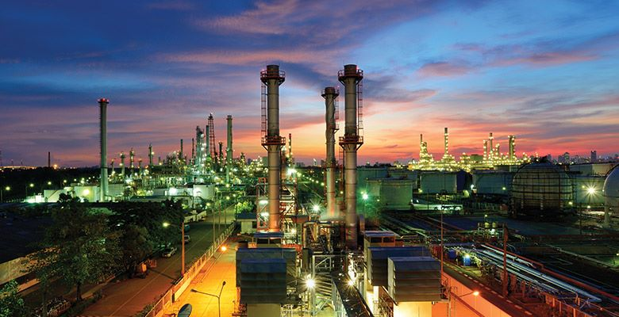

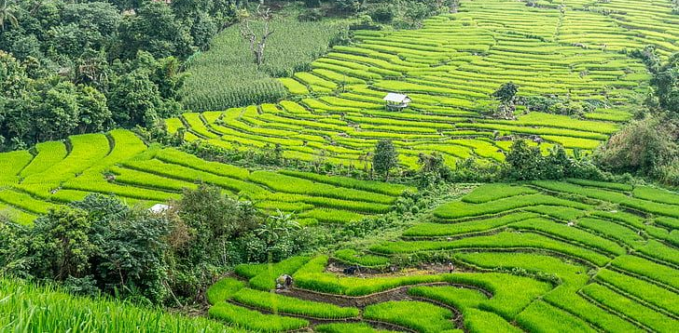
Location considered for analysis
Maharashtra
In Maharashtra, the impact of GST is expected to be significant due to the state's high concentration of businesses and industries. With the removal of the cascading effect of taxes and a simplified tax structure, businesses in Maharashtra are expected to benefit from increased efficiency and reduced compliance costs. This, in turn, is expected to result in increased competitiveness and growth for businesses in the state.
Additionally, Maharashtra has a large population and high population density in urban areas, which are key centers of economic activity. This makes the state an important market for goods and services, and any changes in the tax structure are likely to have a significant impact on the economy.
Manipur
Manipur is a landlocked state in Northeast India, and it heavily relies on imports from other states for various goods and services. Manipur had lower tax rates for certain commodities due to its geographical location and lack of infrastructure. However, with the introduction of GST, the tax rates have become uniform across the country, which means that Manipur may have to pay higher taxes for imports. Manipur has a large informal sector that contributes significantly to its economy, and these businesses may find it difficult to comply with the new GST regulations.
Kerala
The implementation of GST has had mixed impacts on the economy of Kerala. It has led to a reduction in the overall tax burden on businesses, making it easier and less expensive to conduct business. GST could have had an impact on the agriculture sector. Kerala's tourism industry is a major contributor to the state's economy. GST could have affected this industry. The place has a growing manufacturing sector and a large number of small businesses which could have been affected by the compliance requirements and tax rates under GST.

Slide 7
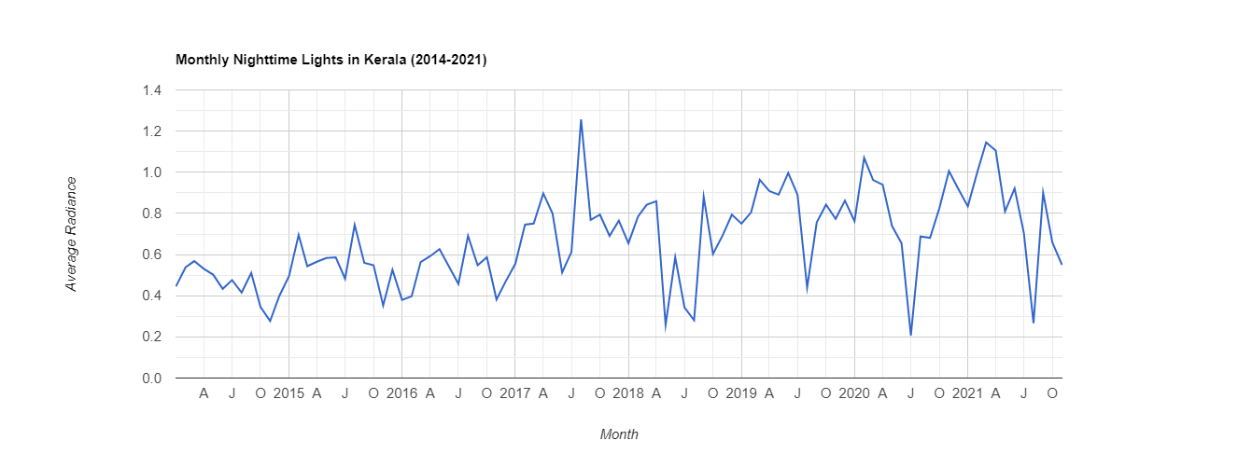

Slide 8
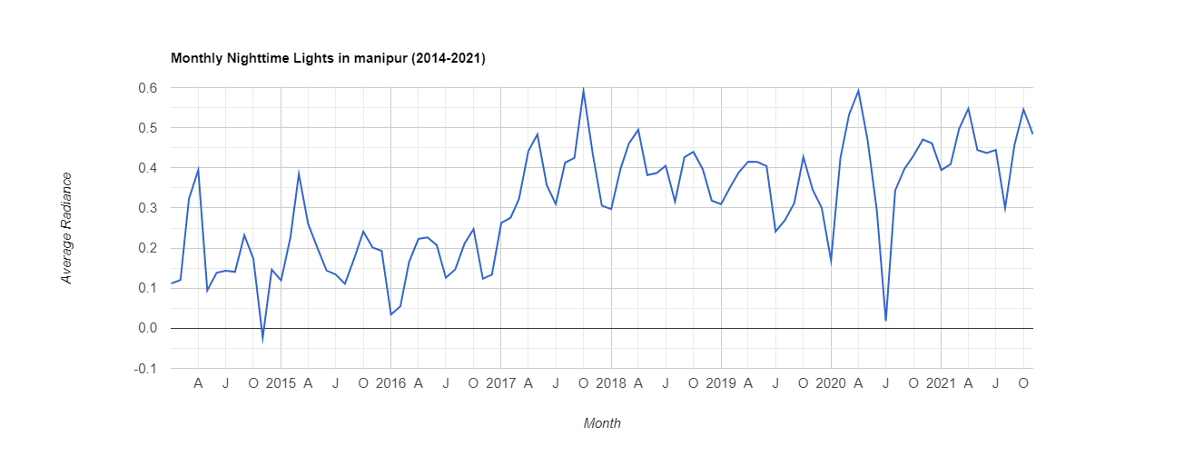

Slide 9
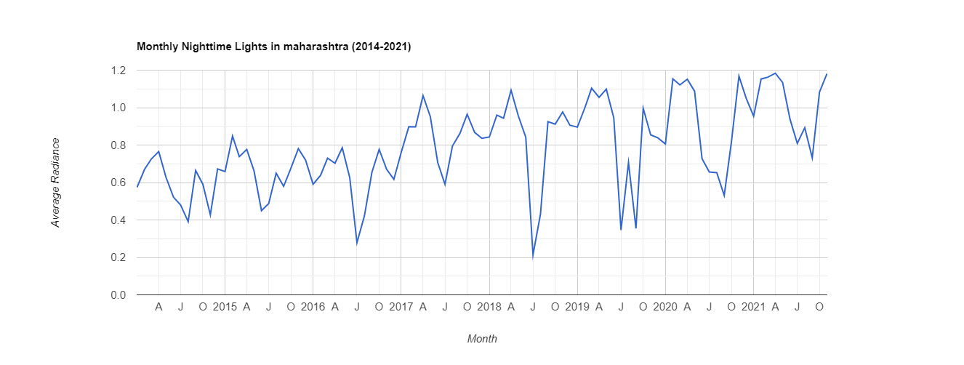

Slide 10
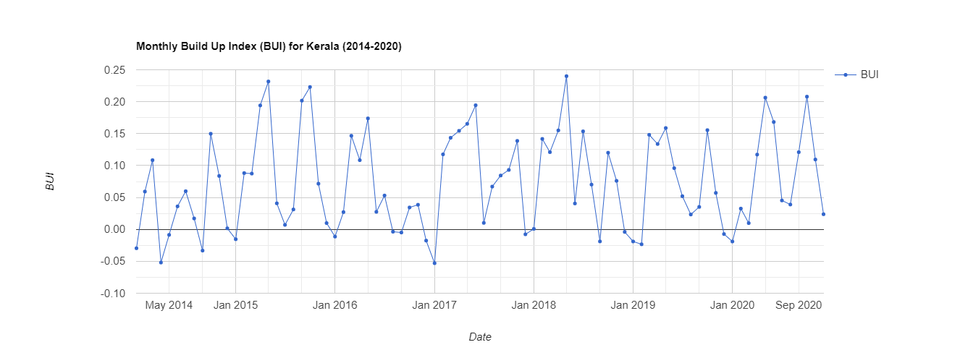

Slide 11
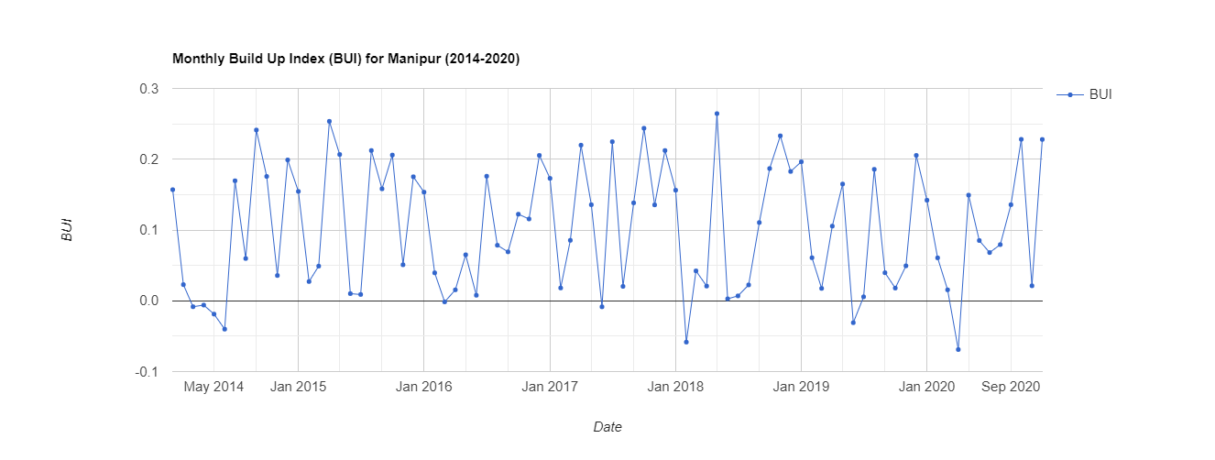

Slide 12
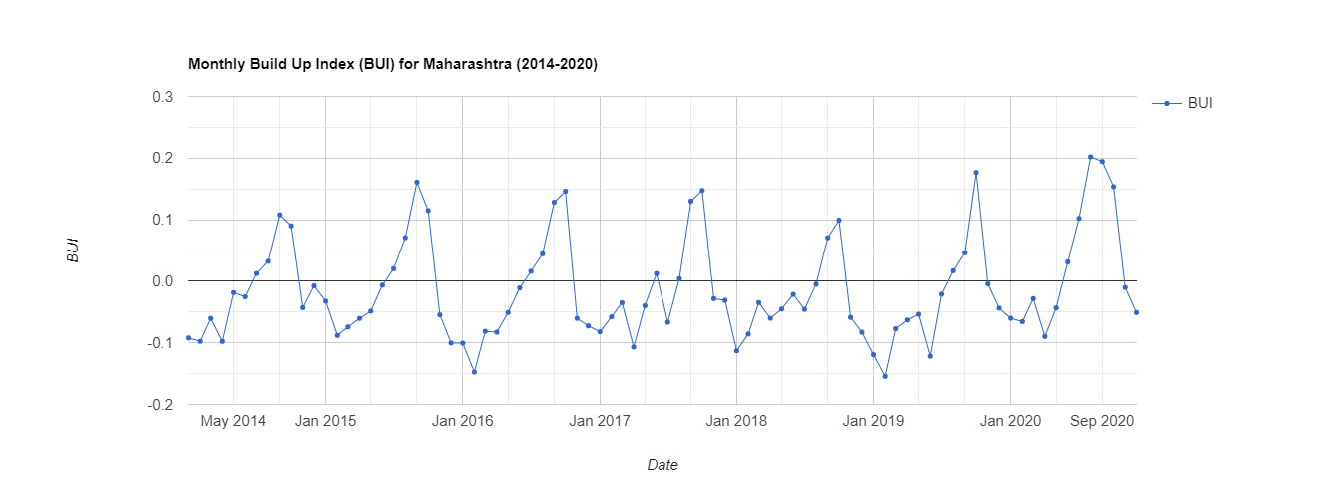

Slide 13
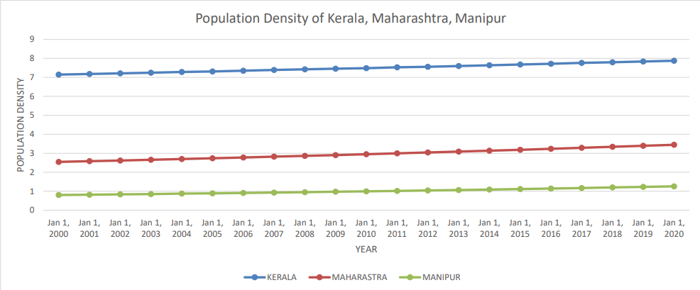
Population density

Slide 14

Calculation
Urbanization index α night time light average radiance
Urbanization index α Build Up Index
Urbanization index α Population density
Hence,
Urbanization index α night time light average radiance × Build Up Index × Population density
Therefore, UI = a × ntl × BUI × Pd
UI = a×X , X = ntl × BUI × Pd

Slide 15
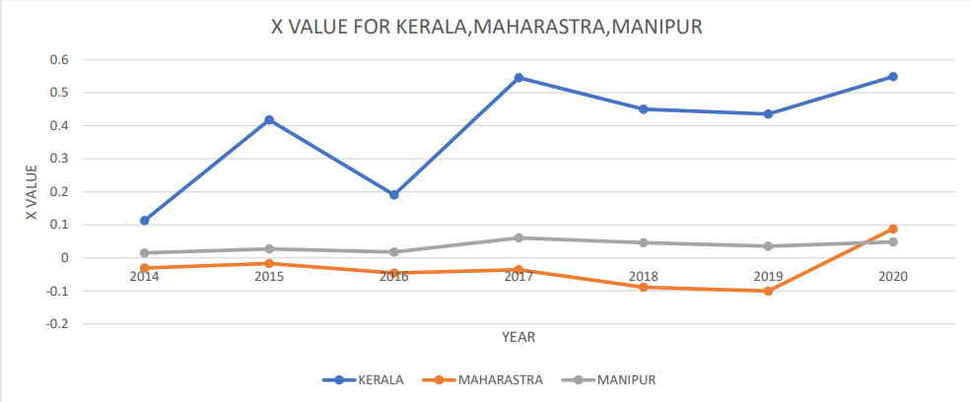

Slide 16
Inference
Kerala had a large change and fluctuation in urbanization indicator X value, this is due to it's higher population index.
Manipur has comparatively lowest degree of change and fluctuation in urbanization indicator X value and it may be because of it's low population index and low degree of industrialization
Maharashtra has a medium degree of change and fluctuation in urbanization indicator X value.

Slide 17
Validation
By the parameters :
Night time light data
Population density
Build Up Index
We understood that the trend hadn't had much impact of implementation of GST.
But , as these data are only the indicators of urbanization and didn't give a direct data about the impact of implementation of GST, we should validate the statement using some real data.
Eg: Gross state domestic product at constant prices.

Slide 18
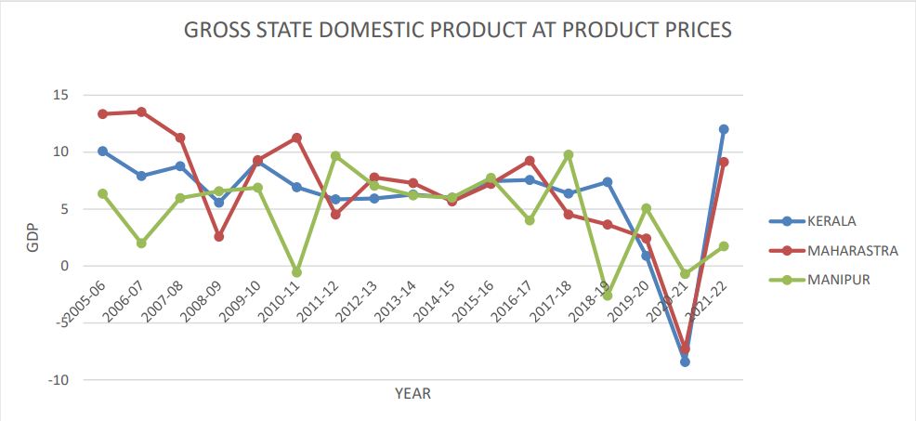

Slide 19
Conclusion
By the above GDP graph, we observed a declining trend in GSDP and then a sudden hype.
During 2017-2018-2019-2020 period, there were a lot of other factors too like the flood, Covid 19, implementation of GST. All these factors together has influenced the declination trend in GDP.
So, the impact of implementation of GST has a mixed effect in Indian economy. But it hasn't affected much in the degree of urbanization happening in each state.
The urbanization was happening faster in Kerala than other but by the study we cannot conclude that it is because of GST implementation.

Slide 20
Reference
Google Earth Engine.
Directorate of Economics & Statistics of respective State Governments, and for All-India -- Central Statistics Office.

Slide 21
Team Members
NEHAKRISHNA C K (B200527CE)
RAJNIKANT PRAJAPAT (B200641CE)

Slide 22
Thank You

